Slide 1
Development of an fine-tuning named entity recognition algorithm

Slide 2
Abstract
Named entity recognition (NER) is a natural language processing method that extracts information from text. NER involves detecting and categorizing important information in text known as named entities. Named entities refer to the key subjects of a piece of text, such as names, locations, companies, events and products, as well as themes, topics, times, monetary values and percentages.
World-best language-models have their own solutions for NER task. More of them use as training dataset CONLL-2003 with limited quantity of entities. Transfer learning methods help train models for NER with new entities using pretrained language models.

Slide 3
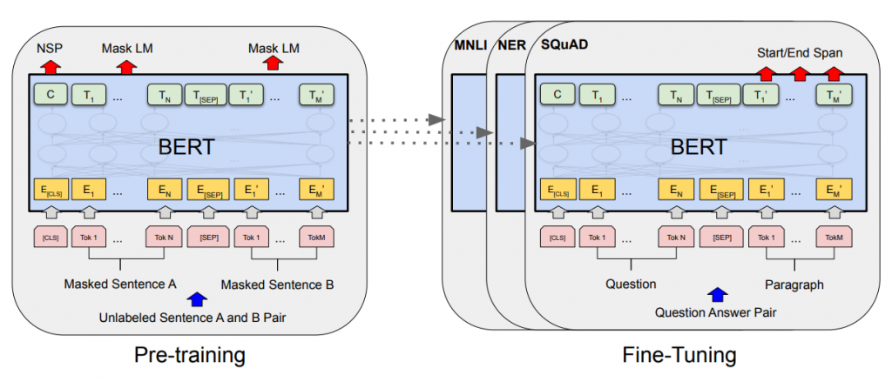
BERT-model
The most popular NLP transfer learning solution is Bert-model. Bert is a family of masked-language models introduced in 2018 by researchers at Google. BERT is based on the transformer architecture and use it’s encoder layers.
It is distinguished by its adoption of self-attention, differentially weighting the significance of each part of the input data. There are two architectures of BERT which in quantity of encoder layers – BERT base and BERT large.
BERT was pre-trained simultaneously on two tasks: language modeling and next sentence prediction. After it can be used in different other tasks with using transfer learning.
Figure 1. BERT model explained
 | Transformer Layers | Hidden Size | Attention Heads | Parameters
BERT base | 12 | 768 | 12 | 110M
BERT large | 24 | 1024 | 16 | 340M
Table 1. Two types of BERT model

Slide 4
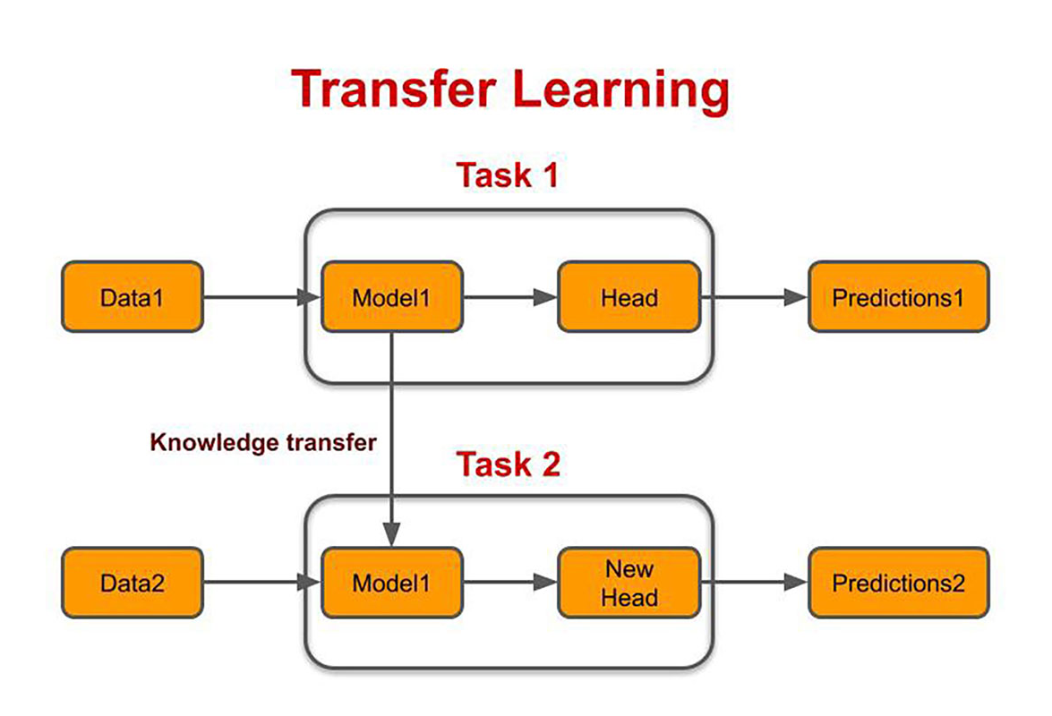
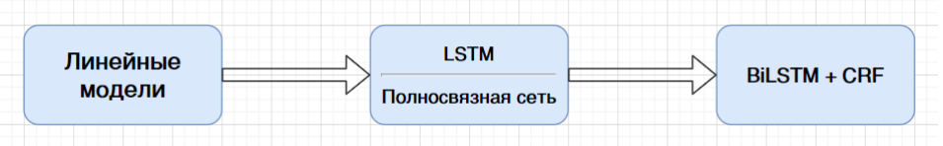
Transfer learning
Transfer learning is a research problem in machine learning that focuses on applying knowledge gained while solving one task to a related task. In current task, BERT transfer learning have two ways:
Freeze layers which not need to be trained and add new net after them;
Use BERT hidden layers and get informative word embeddings from them.
Figure 2. Transfer learning explained
Figure 3. Different models for using BERT hidden layers

Slide 5
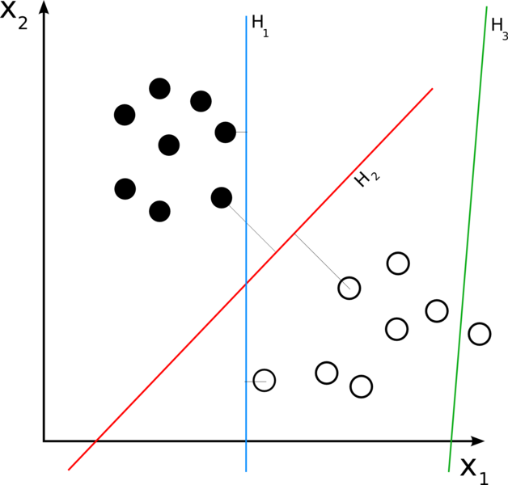

Linear model
In the field of machine learning, the goal of statistical classification is to use an object's characteristics to identify which class it belongs to. A linear classifier achieves this by making a classification decision based on the value of a linear combination of the features. Output score of this combination is:
Figure 4. Support Vector Machine
 | Precision | Recall | F1-score
SVM | 92.6 | 91.2 | 91.8
Table 2. Results of linear classifier

Slide 6
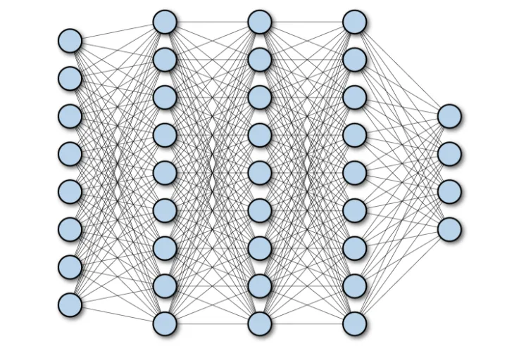
Fully-connected model
A fully connected neural network consists of a series of fully connected layers that connect every neuron in one layer to every neuron in the other layer.
The major advantage of fully connected networks is that they are «structure agnostic» i.e. they can work with all data without some base hypothesis.
Figure 5. Fully-connected NN
 | Precision | Recall | F1-score
Fully-connected | 93.4 | 92.7 | 93
Table 2. Results of fully-connected network

Slide 7
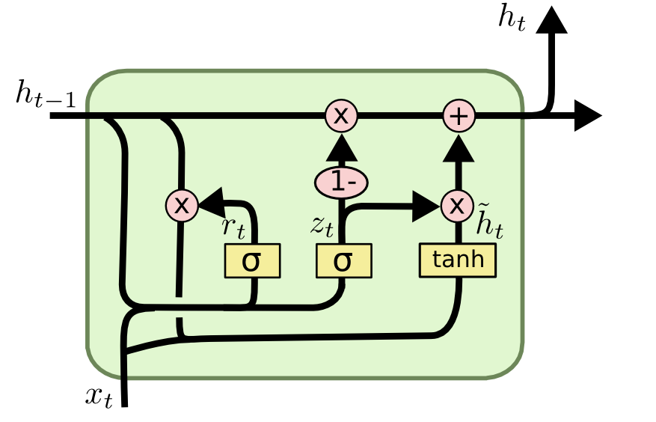
LSTM
LSTM networks are a type of recurrent neural network (RNN) that was developed to deal with circumstances where RNNs failed. When it comes to RNNs, they are networks that function on current inputs while taking into account prior outputs (feedback) and keeping them in memory for a brief period of time (short-term memory). LSTM correct two main problems of RNN:
RNN doesn’t save data for long period of time;
RNN has problem of exploding and disappearing gradients
Figure 6. LSTM cell
 | Precision | Recall | F1-score
LSTM | 89.8 | 91.1 | 90.4
Table 3. Results of LSTM

Slide 8
Results
In this research paper, the problem of fine-tuning named entity recognition network was solved. Two ways of transfer learning method (freezing layers and getting hidden layers as embedding) was used with different additional networks. Final results show that using simple linear or low-layers fully connected models is better that use hidden layers of BERT-model with LTSM architecture. Difficult architecture can be overfitted on hidden states of language-model and fine-tuning algorithm needs only in simple classifier to get good results.

